Slide 1
Industrial policy of India
Notes:
dyhdwhdhhsdjhdjhgmn

Slide 2
INDUSTRIAL POLICY OF INDIA
ANISHKUMAR.P.T
ASSISSTANT PROFESSOR
DEPARTMENT OF ECONOMICS
NSS COLLEGE PANDALAM

Slide 3
INDUSTRIAL POLICY
DEFINITION
The concept of “industrial policy” is comprehensive and it covers all those procedures ,principles ,policies, rules and regulations which control the industrial undertaking of a country and shape the pattern of industrialization .It incorporates fiscal and monetary policies, the tariff policy, labour policy and governments attitude not towards external assistance but the public.

Slide 4
Industrial Policy resolutions
Industrial policy resolution of 1948
Industrial policy resolution of 1956
Industrial policy resolution of 1973
Industrial policy resolution of 1977
Industrial policy resolution of 1980
NEW EONOMIC POLICY 1991

Slide 5
Industrial policy resolution of 1948
The most important policy statement of 1948 IPR are the following foundation .
1.Laid the foundation for Mixed economy
2.Industries were categorized in to 4 broad categories
a.Industries which were to be the exclusive monopoly of the public sector.These were arms and ammunitions,defence production,production and distributon of automic energy,Railway transport and the like..
b.Industries in which new units could be started only by the Government,while existing units in the private sector allowed to continue.
c.Industries which were left to the private sector where the central government could plan and regulate their functioning.
3.It recognized the importance of SSI
4.The importance of harmonious labour relations and the necessity to provide the labourers with fair working conditions were outlined in this policy.
5.Importance of foreign capital but on the hands of Indian personnel.

Slide 6
Industrial policy resolution of 1948
Important distinction was made-
Industries to be kept under :
-public sector,
-private sector and the
-joint sector.
Industrial Department and Regulation Act (IDR Act) was enacted in 1951.
Notes:
*6 th April 1948
*public sector development important
*

Slide 7
Objective of IDR 1951
Empowering the Government to take necessary steps to regulate the pattern of industrial development through licensing.
This paved the way for the Industrial Policy Resolution of 1956, which was the first comprehensive statement on the strategy for industrial development in India.

Slide 8
Industrial Policy Resolution - 1956
Shaped by the Mahalanobis Model of growth, which suggested that emphasis on heavy industries would lead the economy towards a long term higher growth path.
The Industrial Policy Resolution - 1956 classified industries into three categories :
17 industries : exclusively under the domain of the Government. These included inter alia, railways, air transport, arms and ammunition, iron and steel and atomic energy.
12 industries which were envisaged to be progressively State owned but private sector was expected to supplement the efforts of the State.
The third category contained all the remaining industries and it was expected that private sector would initiate development of these industries but they would remain open for the State as well.

Slide 9
Objectives
To accelerate economic growth and boost the process of industrialization as a means to
achieving a socialistic pattern of society.
Removal of regional disparities through development of regions with low industrial base.

Slide 10
Improving living standards and working conditions for the mass of the people.
To reduce disparities in income and wealth.
To prevent private monopolies and concentration of economic power in different fields in the hands of small numbers of individuals
The State will progressively assume a predominant and direct responsibility for setting up new industrial undertakings and for developing transport facilities.
At the same time private sector will have the opportunity to develop and expand.
The adoption of the socialist pattern of society as the national objective.

Slide 11
The IPR 1956 gave due recognition to the importance of SSI
The need for balanced regional development emphasized
Necessity to maintain and promote industrial peace and cordial relations between employers and employees as essential for industrial development.
The need for the development of technical and management education to meet the increasing requirements for such personnel by our industrial units.

Slide 12
INDUSTRIAL POLICY RESOLUTION, 1973
It provided for a closer interaction between the agricultural and industrial sectors. Accorded the highest priority to the generation and transmission of power.
An exhaustive analysis of industrial products was made to identify products which are capable of being produced in the small scale sector.
The list of industries exclusively reserved for the small scale sector was expanded from 180 items to more than 500 items.
Within the small scale sector, a tiny sector was also defined with investment in machinery and equipment upto Rs.1 lakh and situated in towns with a population of less than 50,000 according to1971 census figures, and in villages.
Special legislation to protect cottage and household industries was also proposed to be introduced.

Slide 13
INDUSTRIAL POLICY RESOLUTION, 1977
The Government would promote the development of a system of linkages between nucleus large plants and the satellite ancillaries
To boost the development of small scale industries, the investment limit in the case of tiny units was enhanced to Rs.2 lakh, of a small scale units to Rs.20 lakh and of ancillaries to Rs.25lakh.
A scheme for building buffer stocks of essential raw materials for the Small Scale Industries was introduced for operation through the Small Industries Development Corporations in the States and the National Small Industries Corporation in the Centre.
Industrial processes and technologies aimed at optimum utilisation of energy or the exploitation of alternative sources of energy would be given special assistance, including finance on concessional terms.

Slide 14
This policy expanded the role of public sector not to produce important strategic goods but to ensure essential supplies to the consumers
The IPR 1977 was generally not in favor of foreign collaboration.
This policy made a selective approach to the problem of sick units.

Slide 15
INDUSTRIAL POLICY RESOLUTION 1980
Strengthening of the agricultural base through agro based industries;
Promotion of export-oriented industries;
Promotion of economic federalism through equitable spread of investment and dispersal of returns;
Consumer protection against high prices and bad quality.
Maximum production and achieving higher productivity; Higher employment generation;
Correction of regional imbalances;

Slide 16
IPR 1980
rejuvenate the public sector
and improve operational
efficiency.
The policy aimed at
integrating industrial
development in the private sector
By encouraging the concept of
Economic federalism.

Slide 17
The limits for SSI redefined
The limits for tiny sector was raised from 1 lakh to 2 lakhs.
To increase the limits of investment in the case of small scale units from 10 lakhs to 20 lakhs
To increase the limit of ancillaries from 15 lakhs to 25 lakhs
Special concessions were accorded to large scale units to improve their efficiency and employment potential.
Tightened the regulation towards the sick units.

Slide 18
New INDUSTRIAL POLICY 1991

Slide 19
The spread of industrialization to backward areas of the country will be actively promoted through appropriate incentives, institutions and infrastructure investments.
Foreign investment and technology collaboration will be welcomed to obtain higher technology, to increase exports and to expand the production base.
Abolish monopoly
Workers’ participation in management will be promoted

Slide 20
INDUSTRIAL POLICY 1991 ISSUES
Government recognizes the need for
social and economic justice, to end poverty and unemployment and to build a modern, democratic, socialist, prosperous and forward-looking India
India to grow as part of the world economy and not in isolation
Enhanced support to the small-scale sector so that it flourishes in an environment of economic efficiency and continuous technological up gradation
Emphasis on building our ability to pay for imports through our own foreign exchange earnings

Slide 21
INDUSTRIAL POLICY 1991 OBJECTIVES
In pursuit of the above objectives, Government have decided to take a series of initiatives in respect of the policies relating to the following areas:
Industrial Licensing.
Foreign Investment.
Foreign Technology Agreements.
Public Sector Policy.
MRTP Act.

Slide 22
Industrial Licensing:
Industrial licensing abolished for all projects except a short list of 18 industries related to security and strategic concerns, social reasons, hazardous chemicals etc. (Annex II)
Areas where security & strategic concerns predominate, reserved for public sector. (Annex I)
In projects where imported capital goods are required, automatic clearance given.
In locations other than cities of more than 1 million population, no requirement of obtaining industrial approvals from Central Government.
Incentives & investments in infrastructural development, to promote dispersal to rural and backward areas.
Existing units enabled to produce any article without additional investment.

Slide 23
INDUSTRIAL POLICY 1991
B. Foreign Investment:
Approval upto 51 percent foreign equity in high priority industries.(Annex-III)
Imports governed by general policy applicable to other domestic units, payment of dividents monitored by RBI to ensure that outflows on account of dividents are balanced by export earnings.
Other foreign equity proposals, not covered above, need prior clearance.
A special Empowered Board- to negotiate with a number of large international firms & get FDIs approved.

Slide 24
INDUSTRIAL POLICY 1991
C. Foreign Technology Agreements:
Automatic permissions for foreign technology agreements in high priority industries (Annex-III) upto a lumpsum payment of Rs. 1 crore.
For industries other than those in Annex III, automatic permissions if no foreign exchange is required for payment
All other proposals need specific approval
No permission for foreign technicians, foreign testing of indigenously developed technologies.

Slide 25
INDUSTRIAL POLICY 1991
D. Public Sector Policy:
Portfolio of public sector investments reviewed with a view to focus public sector on strategic, high tech & essential infrastructure.
Chronically sick public enterprises, referred to Board of Industrial & Financial Reconstruction (BIFR).
A part of government’s shareholding in public sector offered to mutual funds, financial institutions, public & workers.
Boards of public sector companies- more professional & powerful.
MOU system- managements would be granted greater autonomy & held accountable.

Slide 26
INDUSTRIAL POLICY 1991
E. MRTP Act: (Monopolistic Restrictive Trade Practices):
Removal of threshold limits of assets in respect of MRTP Companies & dominant undertakings.
Elimination of need of prior approval of Central Government for establishment, expanding, merger, amalgamation & takeover.
Emphasis on controlling & regulating monopolistic, restrictive & unfair trade practices.
Enabling the MRTP Commission to exercise punitive & compensatory powers.

Slide 27
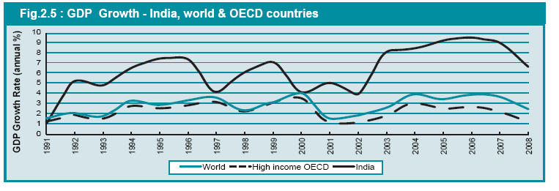

Slide 28
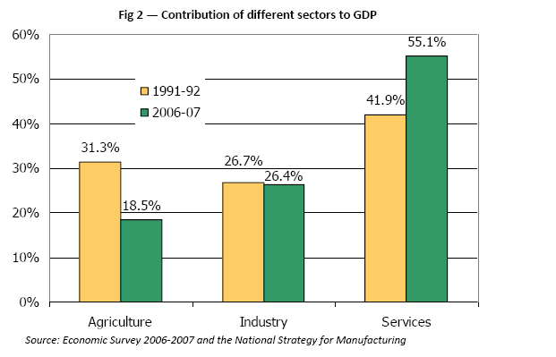

Slide 29
POST 1991-
THE REFORM PHASE

Slide 30
EIGHTH FIVE YEAR PLAN (1992-97)
Expectation- 7.5 per cent
Annually achieved growth rate for industries:
1992-93 : 4.2 percent
1993-94 : 6.8 percent
1994-95 : 9.4 percent
1995-96 : 12.3 percent
1996-97 : 7.7 percent
Average Annual Growth Rate- 8.1 percent

Slide 31
NINTH FIVE YEAR PLAN (1997-2002)
Industrial growth target: 3% p.a.
Achieved: 4.5% p.a.
In 1997-98 and 1998-99, industries reported a growth of 3.8 percent.
Such slow down was due to a number of structural and cyclical factors.

Slide 32
TENTH FIVE YEAR PLAN (2002-07)
Two major reforms that took place from the year 2002 were:
1. RISE IN INTERNATIONAL COMPETITION : Removal of quantitative restrictions on imports.
DECLINE IN ROLE OF PUBLIC SECTOR : Disinvestment process converted many of the existing public sector enterprises into non- governmental enterprises.

Slide 33
INDUSTRIAL GROWTH RATES ANNUALLY :
2002-03 : 6.8 percent
2003-04 : 7.9 percent
2004-05 : 8.9 percent
2005-06 : 8.2 percent
2006-07 : 10.6 percent

Slide 34
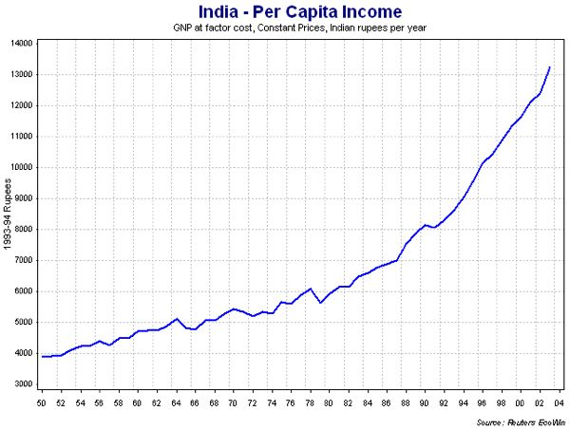

Slide 35
ELEVENTH FIVE YEAR PLAN (2007-12)
Fluctuating trends
2007-08: 15.5 percent
Started declining owing to global economic meltdown
2008-09 : 2.5 percent
2009-10 : 5.3 percent
2010-11 : 8.2 percent
2011-12 : 3.8 percent

Slide 36
India ease of business ranking
142 (2015)
TOPICS | DB 2015 Rank | DB 2014 Rank | Change in Rank
Starting a Business | 158 | 156 | -2
Dealing with Construction Permits | 184 | 183 | -1
Getting Electricity | 137 | 134 | -3
Registering Property | 121 | 115 | -6
Getting Credit | 36 | 30 | -6
Protecting Minority Investors | 7 | 21 | 14
Paying Taxes | 156 | 154 | -2
Trading Across Borders | 126 | 122 | -4
Enforcing Contracts | 186 | 186 | No change
Resolving Insolvency | 137 | 135 | -2
out of 189 economies
Source:world bank

Slide 37
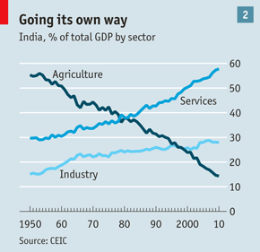

Slide 38
TWELVTH FIVE YEAR PLAN (2012-17)
CHALLENGES FACING :
Dumping in Indian markets
Indian Industry needs to be cost effective along with delivering value.
Ensuring that investments made in infrastructure projects fructify quickly.
Growth of labour intensive industries.

Slide 39
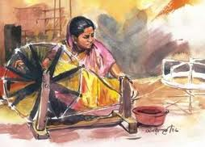
ACTIVITY : POLICY DILEMMA
Khadi, which symbolized self-reliance and emancipation during the freedom struggle in India, has lost its sheen over the years.
In 1957, the Khadi and Village Industries Commission (KVIC) was established to take over the work of the board. KVIC was formed as a nodal agency to promote Khadi all over India through its exclusive outlets known as Khadi Bhandars. There were many bogus Khadi units operating in the country, which made it extremely difficult to claim rebates from the Government of India for the sale of Khadi.
You are the Home Minister of INDIA. Prepare a clause in the existing Industrial Policy of India to deal with the above stated problem.

